Slide 1
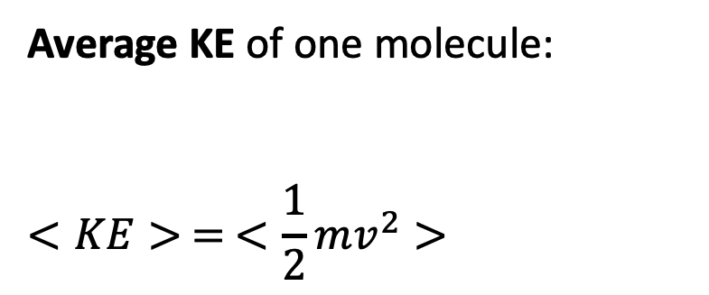
Why is $c$ (or $<v^{2}>^{1/2}$) interesting?
Average KE of one molecule:
$$<KE> = <\frac{1}{2}mv^{2}>$$

Slide 2
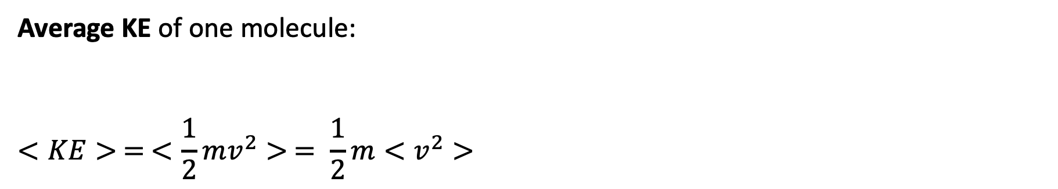
Why is $c$ (or $<v^{2}>^{1/2}$) interesting?
Average KE of one molecule:
$$<KE> = <\frac{1}{2}mv^{2}> = \frac{1}{2}m<v^{2}>$$

Slide 3
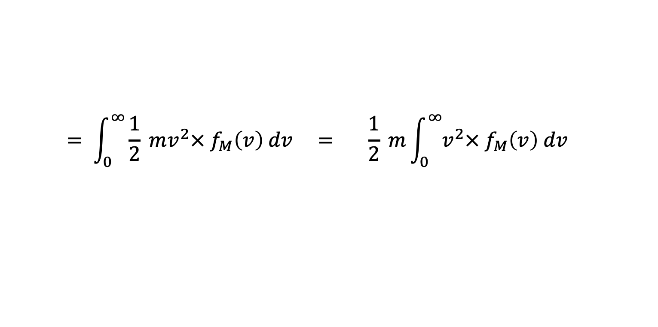
Why is $c$ (or $<v^{2}>^{1/2}$) interesting?
Average KE of one molecule:
$$<KE> = <\frac{1}{2}mv^{2}> = \frac{1}{2}m<v^{2}>$$
$$= \int_{0}^{∞}{\frac{1}{2} mv^{2}× f_{M}\left(v\right) dv} = \frac{1}{2} m\int_{0}^{∞}{v^{2}× f_{M}\left(v\right) dv}$$

Slide 4
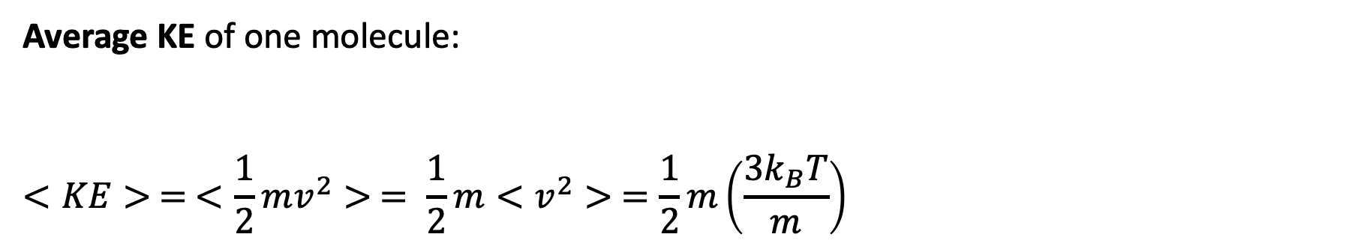
Why is $c$ (or $<v^{2}>^{1/2}$) interesting?
Average KE of one molecule:
$$<KE> = <\frac{1}{2}mv^{2}> = \frac{1}{2}m<v^{2}> =\frac{1}{2}m\left(\frac{3k_{B}T}{m}\right)$$

Slide 5
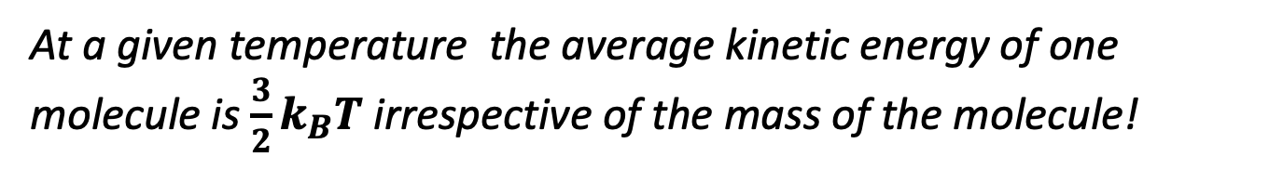
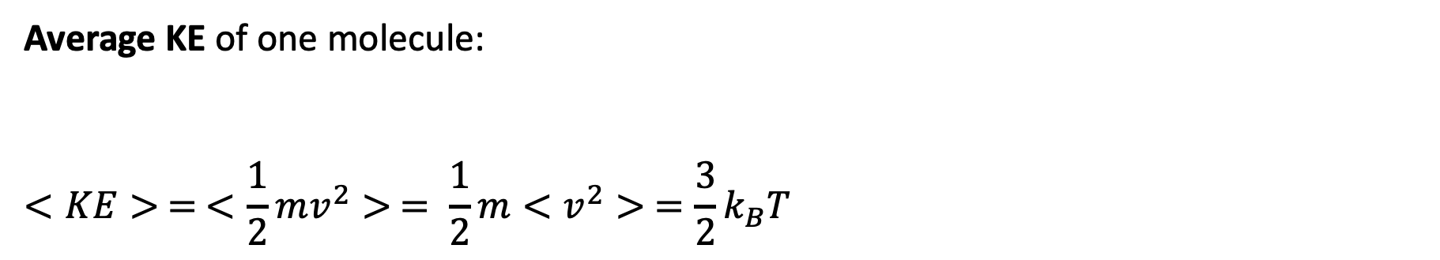
Why is $c$ (or $<v^{2}>^{1/2}$) interesting? (finally, an answer)
Average KE of one molecule:
$$<KE> = <\frac{1}{2}mv^{2}> = \frac{1}{2}m<v^{2}> =\frac{3}{2}k_{B}T$$
At a given temperature the average kinetic energy of one molecule is $\frac{3}{2}k_{B}T$ irrespective of the mass of the molecule!

Slide 6
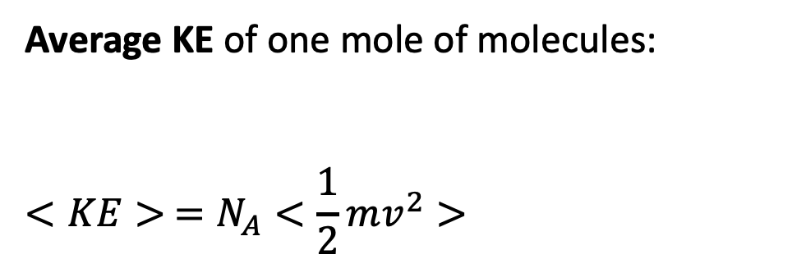
Scaling up
Average KE of one mole of molecules:
$$<KE> =N_{A}<\frac{1}{2}mv^{2}>$$
Pretend there are 6.02 x 10²³ of these

Slide 7
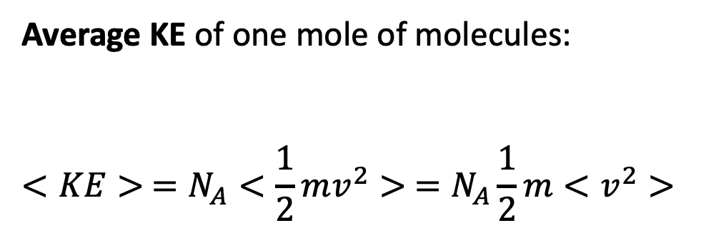
Scaling up
Average KE of one mole of molecules:
$$<KE> =N_{A}<\frac{1}{2}mv^{2}> =N_{A}\frac{1}{2}m<v^{2}>$$
Pretend there are 6.02 x 10²³ of these

Slide 8
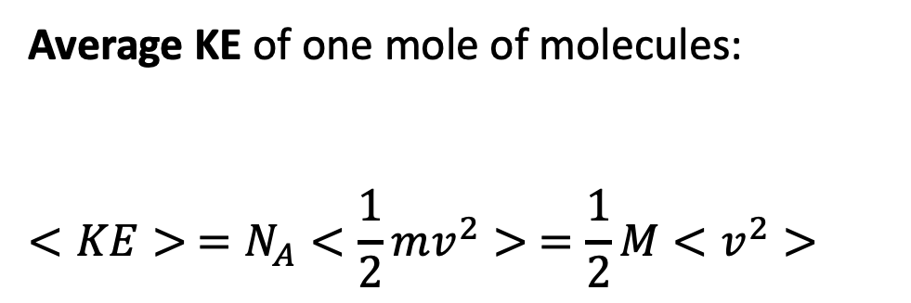
Scaling up
Average KE of one mole of molecules:
$$<KE> =N_{A}<\frac{1}{2}mv^{2}> =\frac{1}{2}M<v^{2}>$$
Pretend there are 6.02 x 10²³ of these

Slide 9
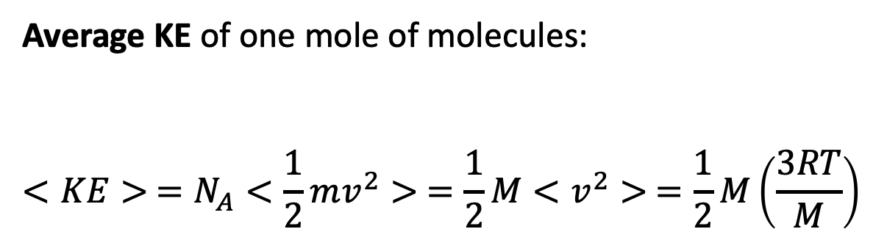
Scaling up
Average KE of one mole of molecules:
$$<KE> =N_{A}<\frac{1}{2}mv^{2}> =\frac{1}{2}M<v^{2}> =\frac{1}{2}M\left(\frac{3RT}{M}\right)$$
Pretend there are 6.02 x 10²³ of these

Slide 10
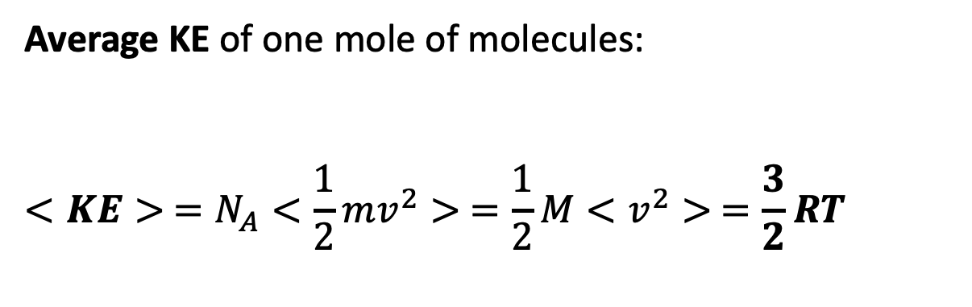
Scaling up
Average KE of one mole of molecules:
$$<KE> =N_{A}<\frac{1}{2}mv^{2}> =\frac{1}{2}M<v^{2}> =\frac{3}{2}RT$$
Pretend there are 6.02 x 10²³ of these

Slide 11
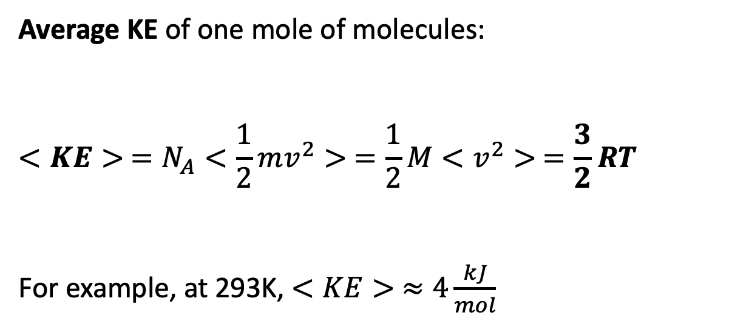
Scaling up
Average KE of one mole of molecules:
$$<KE> =N_{A}<\frac{1}{2}mv^{2}> =\frac{1}{2}M<v^{2}> =\frac{3}{2}RT$$
For example, at 293K, $<KE> ≈4\frac{kJ}{mol}$
Pretend there are 6.02 x 10²³ of these

